Slide 1
Genome Markers

Slide 2
Scenario
One Node – Namawala
0 initial prevalence
Constant temperature
x_Temporary_Larval_Habitat=0.1
TRACK_ALL_VECTORS
1000 people
4 markers
4 outbreaks on day 10
Each outbreak has one marker
0.01 coverage
Goals
See infections develop different combinations of markers
Test
ReportNodeDemographicsMalaria
ReportVectorStats
OutbreakIndividualMalaria
New Genome_Markers config parameter

Slide 3
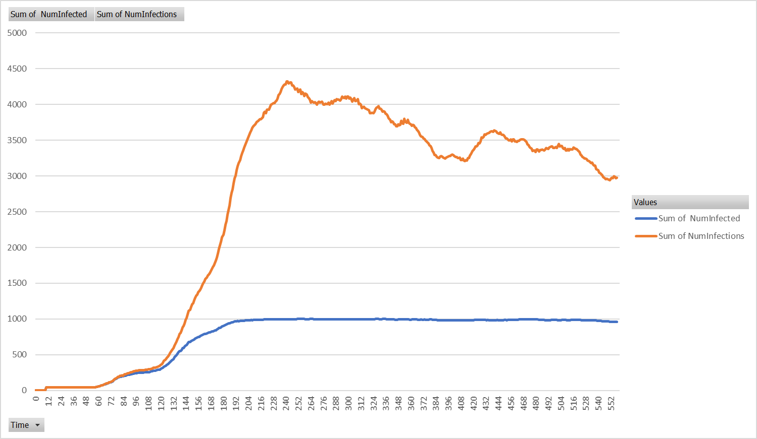
3.5 Infections per Person

Slide 4
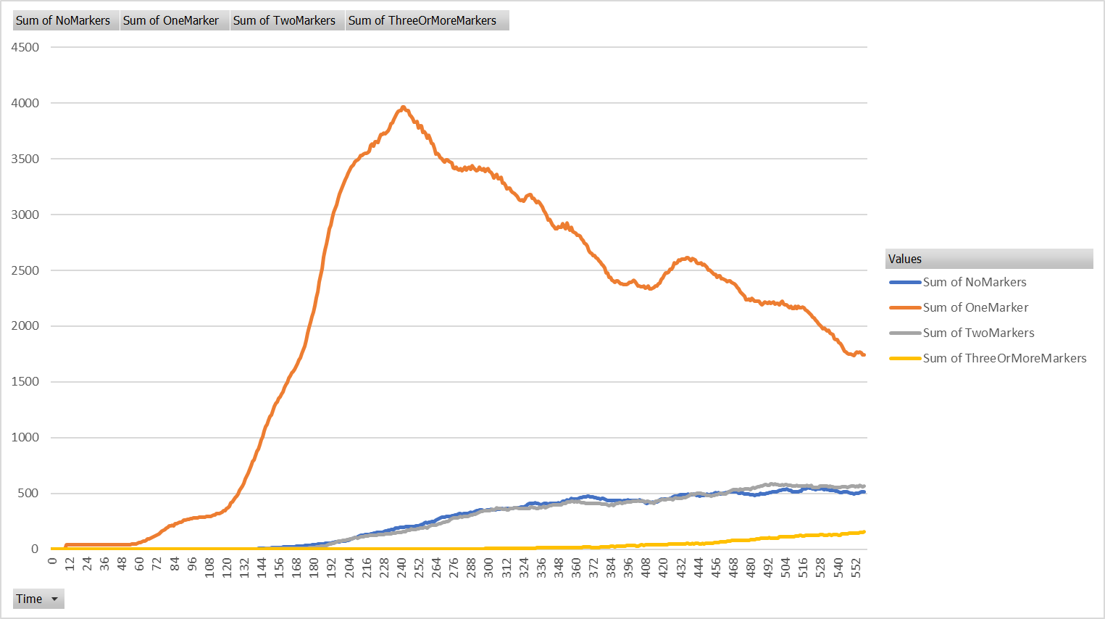
Markers Combine and Disappear

Slide 5
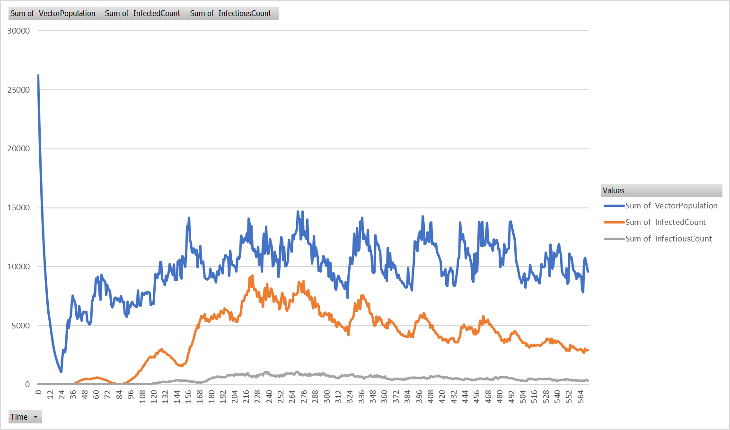
Vectors

Slide 6
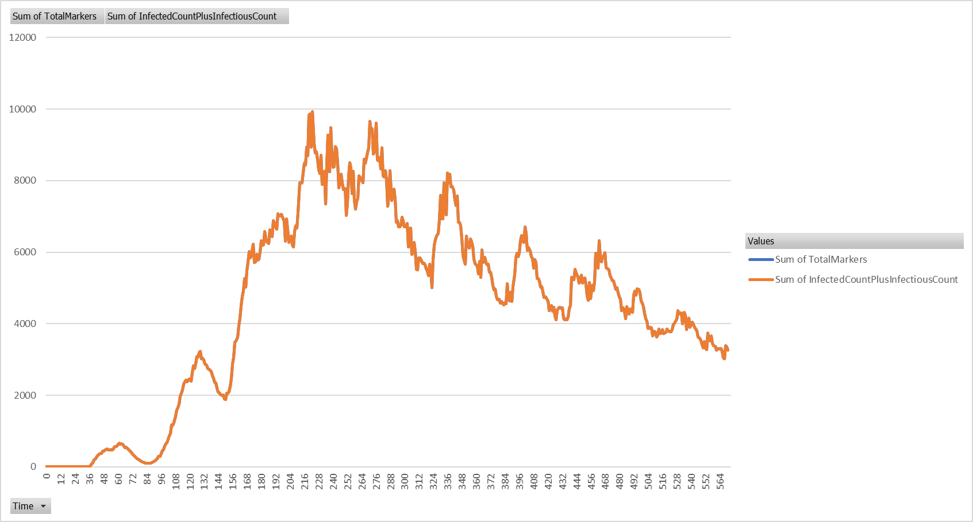
Keeping track of vector infections

Slide 7
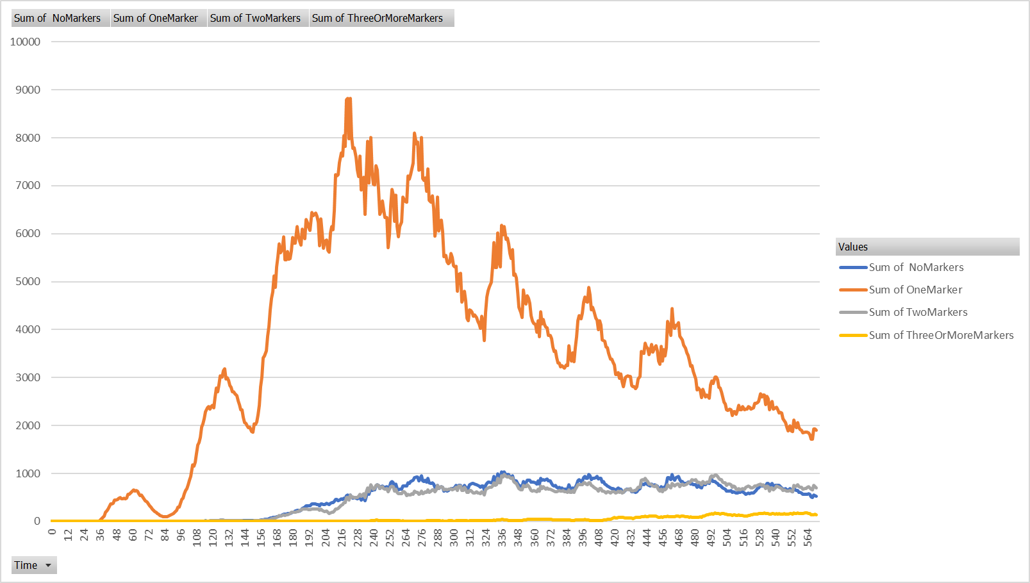
Markers Combine and Disappear in Vectors

Slide 8
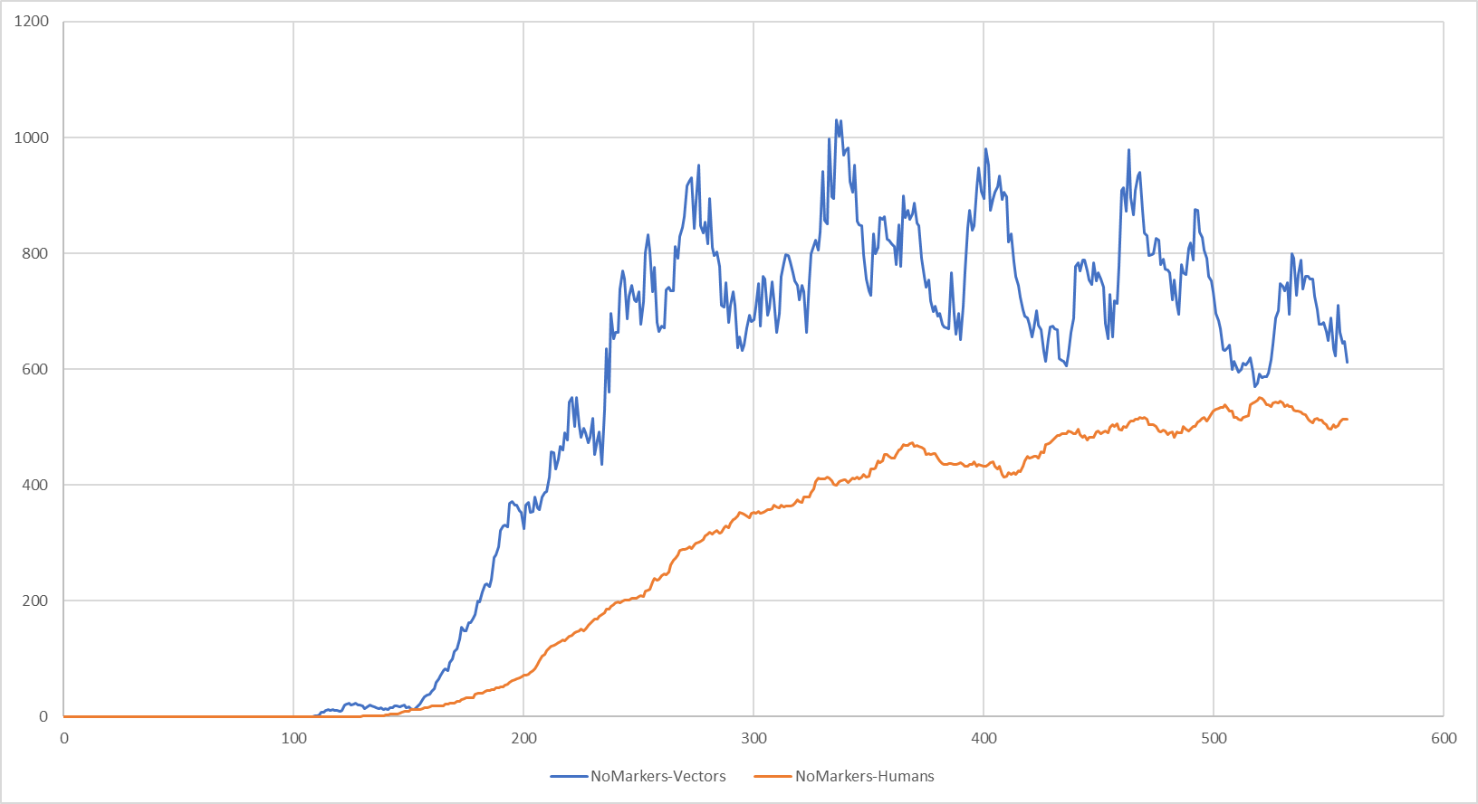
Infections with No Markers – Human vs Vector

